Slide 1
Low Power Wide Area Networks (LPWAN)
Frank Walsh

Slide 2
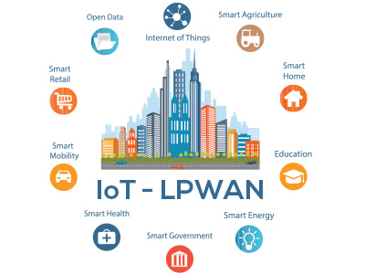
What’s LPWAN
wireless telecommunication wide area network designed to allow long range communications.
Significant characteristics
Low power
Low bit rate
Wide Area

Slide 3
Why LPWAN
Useful for independent devices
Access to remote locations
Suitable for physically, energy, and computationally constrained devices
Suited to IoT!

Slide 4
Why LPWAN for IoT
IoT devices deployed in “the field”
Direct access without gateways etc.
Simpler with reduced cost
Short range wireless (Zigbee, Bluetooth etc.) requires infrastuture set up:
Firewalls, gateways, NAT etc.

Slide 5
LPWAN usage
100s of bits/second.
Multimedia
Documents
Sensor data
Location data
Machine 2 Machine data

Slide 6
LPWAN and IoT
Some use cases not suitable for standard wireless tech
Can provide back-up connectivity for higher BW devices.

Slide 7
Comparison

Slide 8
LPWAN Topologys
Star Topology
No need for wireless network routing protocols
Direct Connection:

Slide 9
LPWAN Topologies
Indirect Device connection:
Devies connected to gateway using BLE/Zigbee.
Gateway typically mains powered
Can provide greater security at gateway

Slide 10
Link Budget

Slide 11
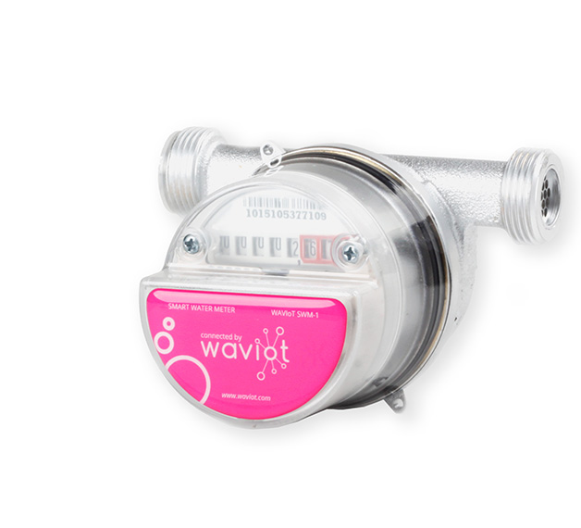
Use Cases – Smart Metering
Commodity consumption
No need for visits/concentrators

Slide 12
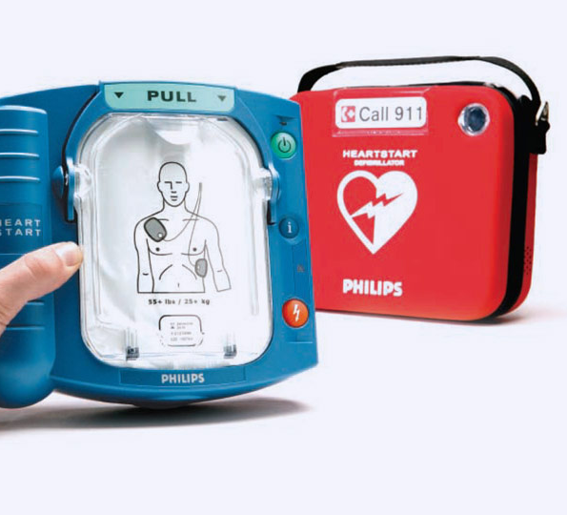
Use Case – Utility Monitoring
Fire Hydrants
Portable Defoliators
Need to be sure they function when required

Slide 13
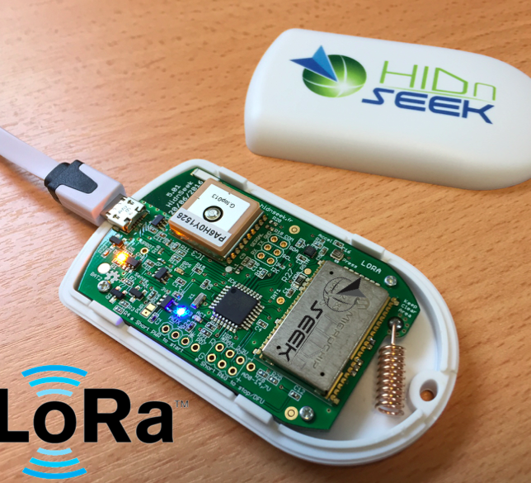
Use Case - Tracking
Track location of goods/Equipment

Slide 14
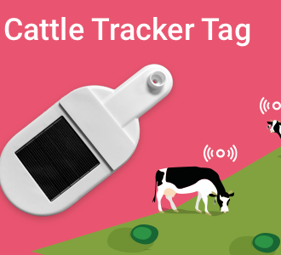
Use case - Agriculture
Monitor livestock and envornment

Slide 15
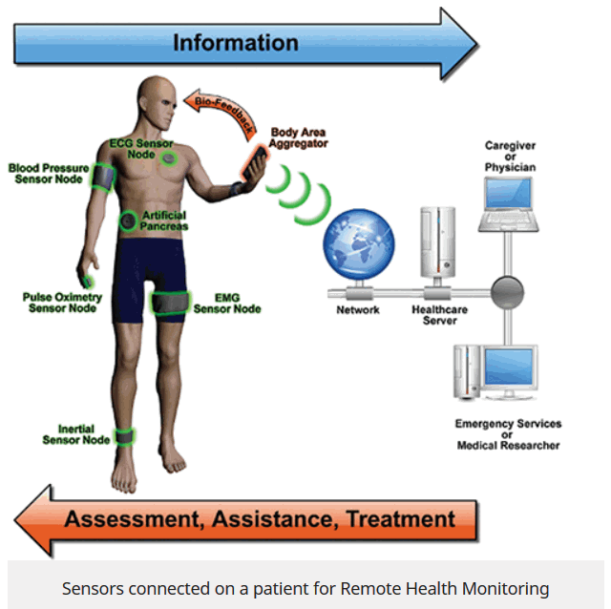
Use Case – “Silver Economy”
Proactive Health monitoring

Slide 16


LPWAN Technologies
Sigfox
proprietary technology
communication using the Industrial, Scientific and Medical ISM radio band
868MHz in Europe and 902MHz in the US
LoRaWAN
LoRa alliance is an open, non-profit association of members.
intended for wireless battery operated Things in a regional, national or global network.

Slide 17
SigFox Introduction
Market leader
One network
No roaming
Nearly full coverage in Ireland/France and large parts of Europe
Open hardware approach
Sell access to service

Slide 18
Range
Best case scenario
100km line of sight
Typical
Few kms (city) to 10s kms (country)

Slide 19
Outdoor and Indoor
Good Indoor propagation
We’ll find out…
There will be signal attenuation

Slide 20
Messages
Payload up to 12 bytes
Up to 140 times each day from a device (About 100b/s)
Devices can receive data from application

